Slide 1

Physician & Provider Service Distribution in California
By: Jeneice George, Matt Jensen, Emory Mansuetti, Veerpal Sanga, and Andrew Schell

Slide 2

Introduction for the Team
Background in Healthcare
Passionate about patient-care and healthcare accessibility
Backgrounds led us to examine healthcare-related topics
Growing interests in healthcare data analytics

Slide 3
Sources of Data
Census API 2019
American Community Survey – ACS 5
Enrolled Medi-Cal Fee-for-Service (FFS) Providers (CSV)
California Health and Human Services Open Data

Slide 4
Core Message and Hypothesis of the Project
Hypothesis: Is there is difference in distribution or access to specialty and primary care services based on a region’s average per capita income?
Follow-Up: Does the size of a county’s population affect the number of physicians and the types of specialties that are accessible to people living in that county?
Core Message: Want to examine how census demographics are related to the availability of physicians and providers as well as the varieties of specialty services that are accessible in different areas depending on the poverty count in the county.
Notes:
Core hypothesis
Core question (expand)
Secondary question (regression)

Slide 5

Data Cleanup and Exploration
Started with dataset of geocoded clinics
It did not have good breakdown of specialties or physician count
Wanted more information pertaining to census, county, and specialty
Exploring provider data
National Provider Identifier (NPI) that distinguishes each physician
Limit the provider type code to physicians within the state of California
Standardized the zip code to 5 digits to prepare to merge the provider data to the census data
Notes:
Switch to JUPYTER NOTEBOOK
Started with smaller dataset (Emory’s code on Git Hub)
Wanted to go bigger scope,
It did not have good breakdown of specialties or physician count
Wanted more information
Provider data

Slide 6
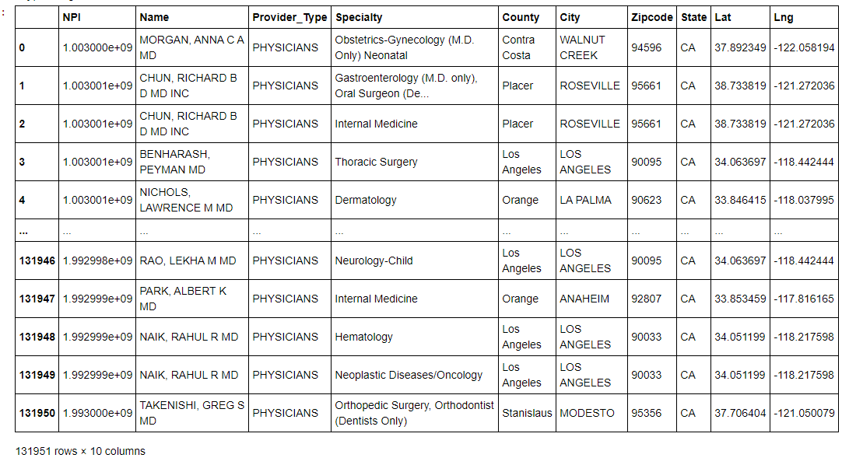
Notes:
Screenshot of data cleanup from git hub
- First codes we started with

Slide 7
Data Analysis
Merged the 2019 census and provider data on zip code
Took a subset of this merged data and grouped this subset by county and zip code
Account for duplicated zip codes for providers with multiple specialties, same location
Find unique zip codes within the merged dataset
Find number of different physicians within the unique sip codes
Notes:
SwitJUPYTER NOTEBOOK

Slide 8
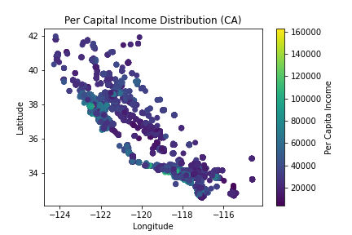
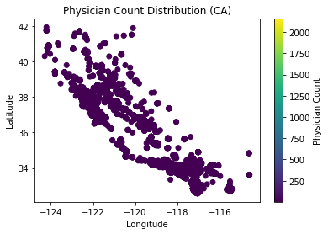
Per Capita Income and Physician Count Distribution Across California

Slide 9
Discussion of Findings
Notes:
Regression model
Provider per 10k per pop and poverty rate
Was no relationship between these variables
Cannot reject the null hypoethsis
There were no statistically significant differences

Slide 10
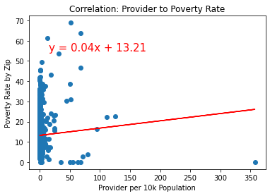
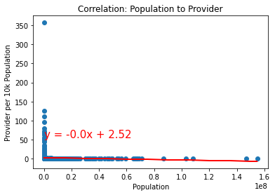
Linear Regression Model
Provider to Poverty Rate: If the number of providers is not related to poverty rate, then increasing the amount of providers in a county will not have an affect on the poverty rate in the area.
Cannot reject null hypothesis (H0)
Population to Provider: If the size of the population within a county is not related to the amount of physicians in that county, then a high or low population size will have no impact on the amount of providers available in the county area.
Cannot reject H0

Slide 11
Post-Mortem – Difficulties and Additional Questions that Came Up
From the graphs, the physician count distribution was not linear
Differences were not great enough to the change the number of physicians available in the county/zip codes
Outliers were hidden and not showing well in the color bar scatter plots
Creating column names during the data cleanup
Further Questions:
Is the type of specialty services related to population size of a county?
How is the average per capita income within a county related to the types of specialty services available?
Notes:
Graphs
Physician count distribution was not linear
Differences were not great enough to change the count
Had the colored dots covering the outliers
The outliers were not showing well on the colorbar
Cleaning up the column names
Slide in back of presentation (3rd bullet): Geocode Providers
APPENDIX for our thought process or what we initially set out to do
Describe other things we considered
Did not end up using it for official project

Slide 12
Thank you!
Any Questions?

